Slide 1
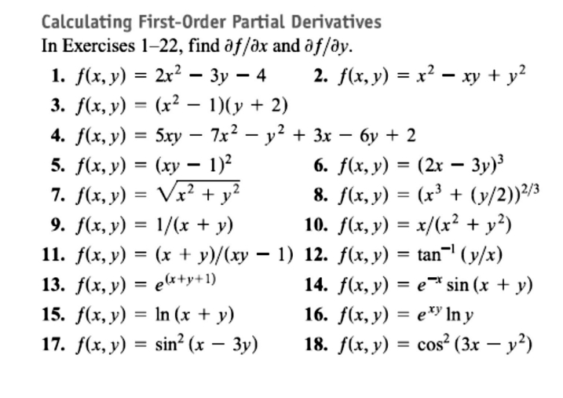
8 / Dep. Of Engineering Mechanics
th
Class: 2 AMTHMATICS / T he Partial Derivatives

Slide 2
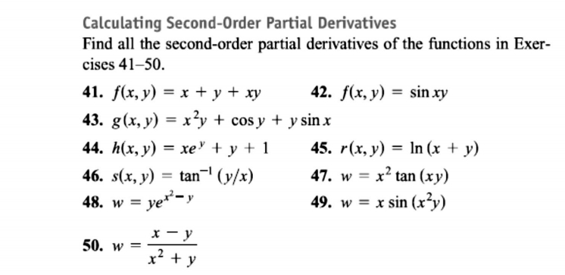
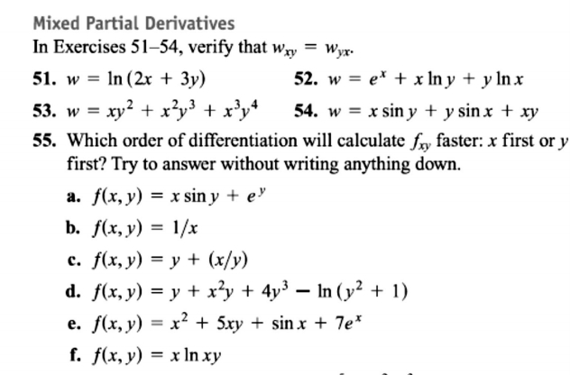
9 / Dep. Of Engineering Mechanics
th
Class: 2 AMTHMATICS / T he Partial Derivatives

Slide 3
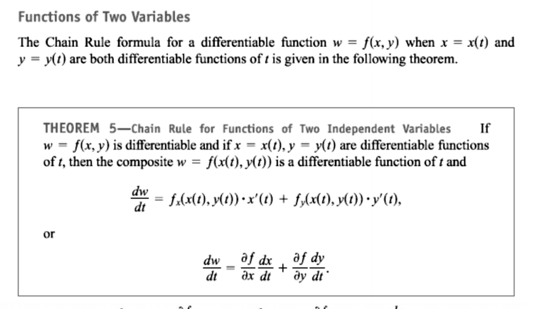
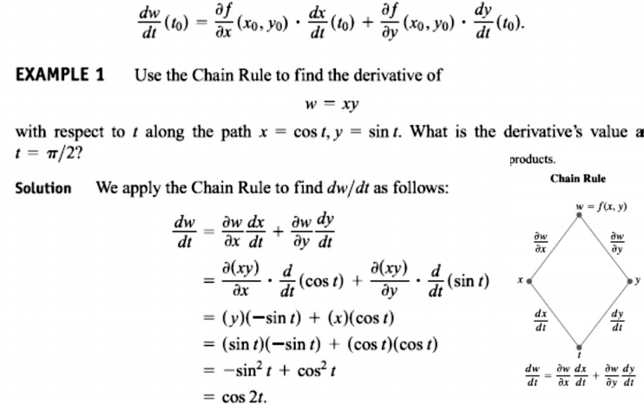
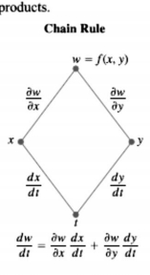
10 / Dep. Of Engineering Mechanics
th
Class: 2 AMTHMATICS / T he Partial Derivatives

Slide 4
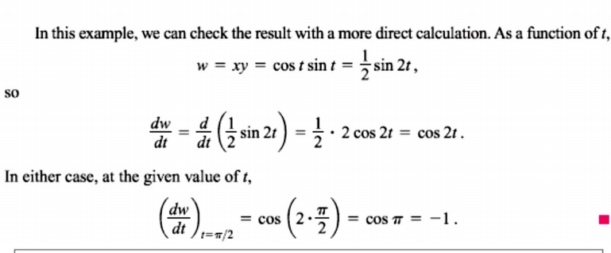
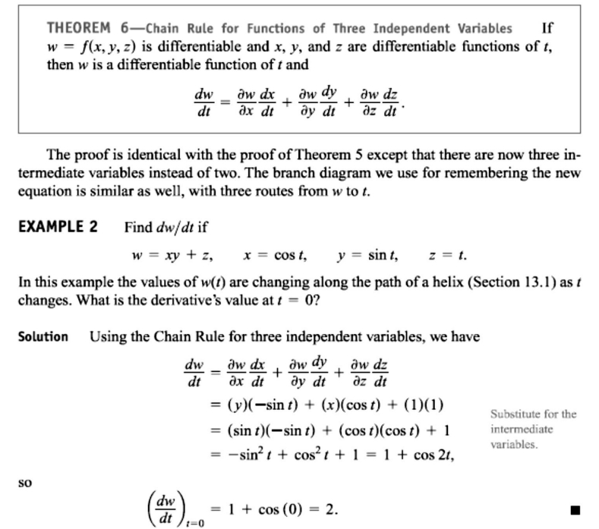
11 / Dep. Of Engineering Mechanics
th
Class: 2 AMTHMATICS / T he Partial Derivatives

Slide 5
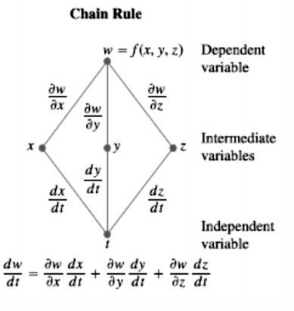
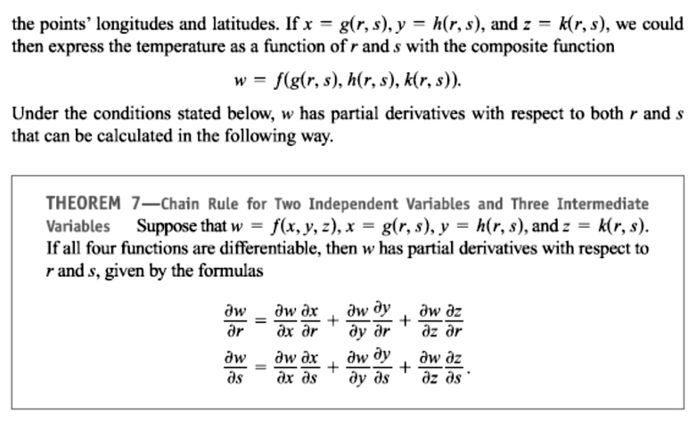
12 / Dep. Of Engineering Mechanics
th
Class: 2 AMTHMATICS / T he Partial Derivatives

Slide 6
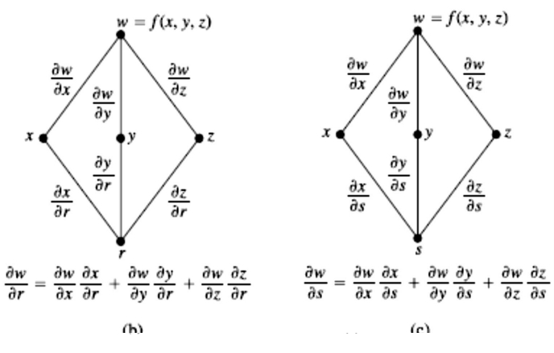
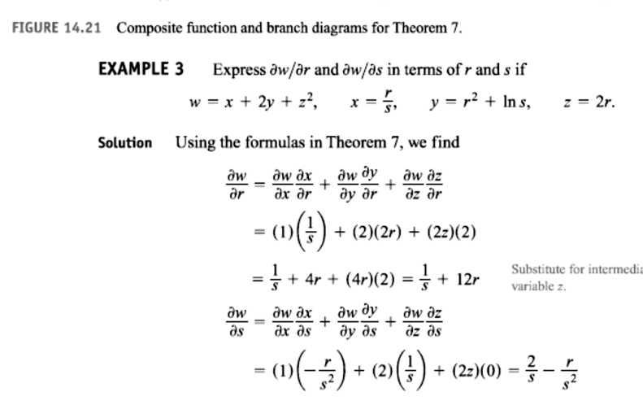
13 / Dep. Of Engineering Mechanics
th
Class: 2 AMTHMATICS / T he Partial Derivatives

Slide 7
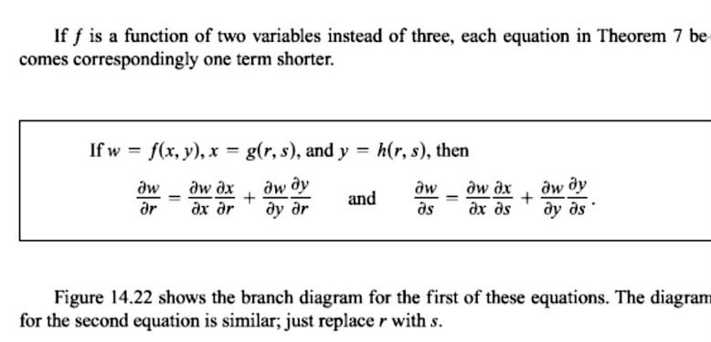
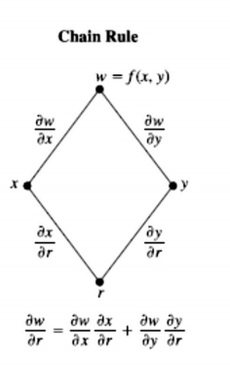
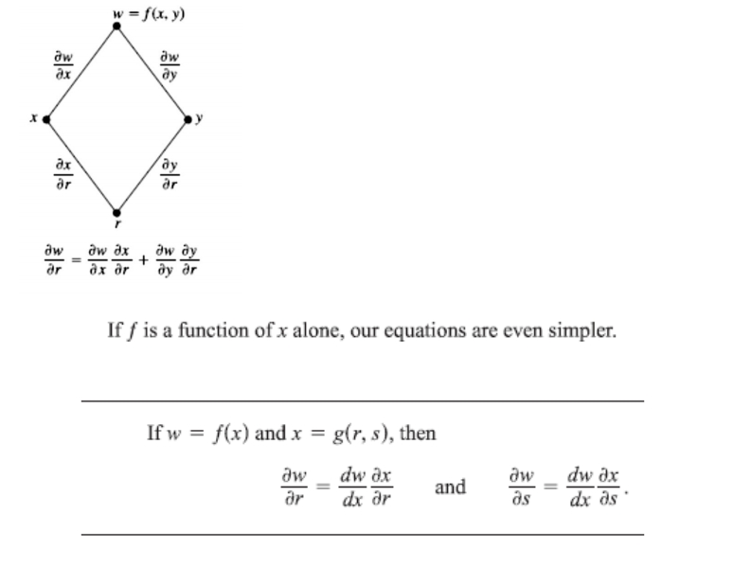
14 / Dep. Of Engineering Mechanics
th
Class: 2 AMTHMATICS / T he Partial Derivatives

